Slide 1


<Insert Picture Here>
22 Big Data Spatial and Graph

Slide 2
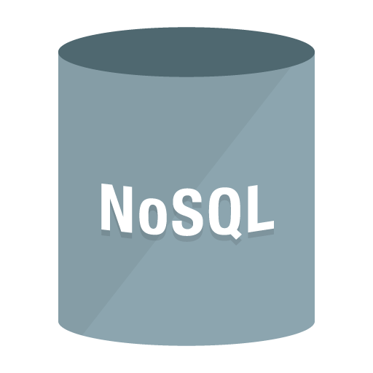



Oracle’s Spatial and Graph Strategy
Enable Spatial and Graph use cases on every platform
Oracle Big Data Spatial and Graph
Oracle Database
Spatial and Graph
Spatial and Graph in Cloud Offerings
NoSQL
Big Data:
Single Model Data Store
Database 12c:
Polyglot (Multi-model) Data Store
Notes:
HOW MANY KNOW ABOUT ORACLE S&G?
HOW MANY KNOW WE HAVE S & G AS PART OF DB CLOUD AND BIG DATA CLOUD?
HOW MANY KNOW WE HAVE BIG DATA S & G?
Oracle is a leader in offering technologies to perform geospatial analysis and graph analytics. We have thousands of users including the world’s largest mapping agencies, central, state and local governments, media and health sciences, transportation, utility, and telecommunications companies as well as energy, defense, intelligence, finance, insurance and retail organizations.
We have had a clear and consistent vision to exploit the advances in Oracle’s technologies to address the spatial and graph requirements of our customers and to enrich Oracle technologies, applications, tools and services with spatial and graph analysis capabilities.
Oracle Big Data Spatial and Graph was launched in May 2015.
Our strategy has been to extend the spatial and graph capabilities that we already have on Oracle Database on every Big Data platform. This doesn’t mean that we just have the same functionality as the Oracle Database. Our goal is to add spatial and graph capabilities to address use cases on every Big Data platform whether it’s Hadoop, NoSQL, or the cloud.
The idea is to use these platforms to address spatial and graph workloads and then apply spatial and graph analysis to the use cases that are best addressed by these on-premise and cloud technology platforms.

Slide 3

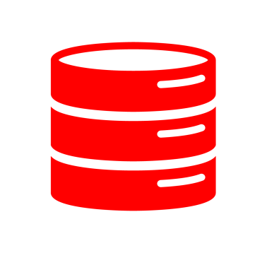
Big Data Platform
Hadoop
NoSQL
Data in files, NoSQL
Parallel programming model
Scalable processing
Ideal for high volume, unstructured data storage and processing
Data organized for fast query
Simple programming models
Elastic scale out
Little or no fixed data model
Access specific record
Notes:
NOT JUST BDA. OTHER HADOOP/HBASE/NOSQL PLATFORMS

Slide 4
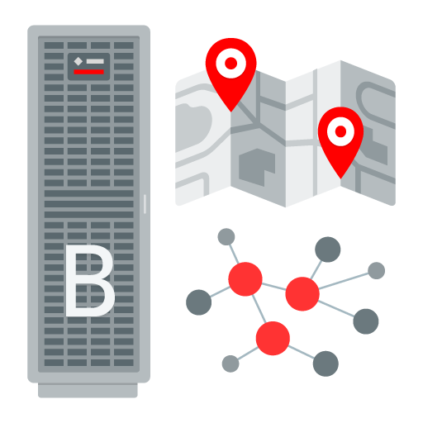
Graph and Spatial Analysis – It is about relationships
Are things in the same location? Who is the nearest? What tax zone is this in? Where can deliver in 35 minutes? What is in my sales territory? Is this built in a flood zone?
Which supplier am I most dependent upon? Who is the most influential customer? Do my products appeal to certain communities? What patterns are there in fraudulent behavior?

Slide 5
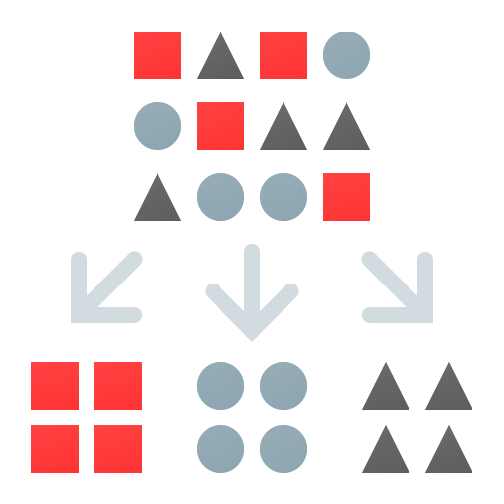
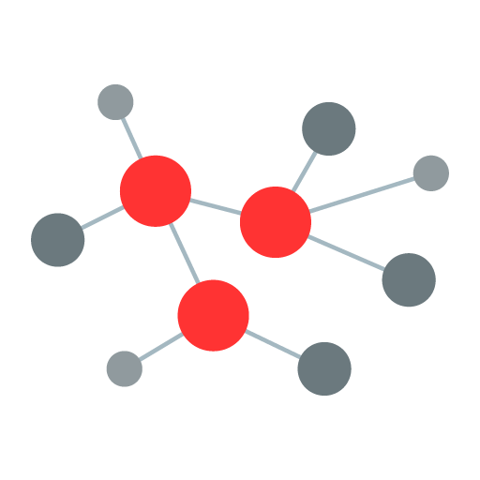
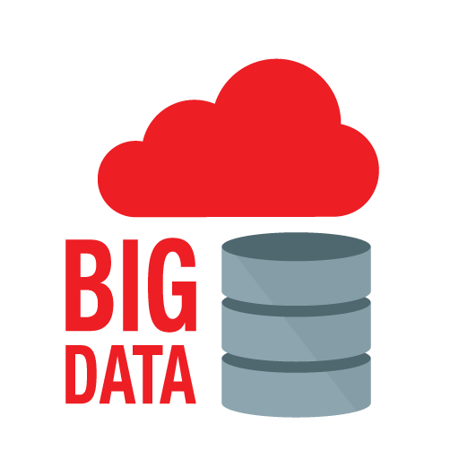
Big Data Spatial and Graph
Big Data often needs an organizing principle – Data Harmonization Big Data analysis is often about relationships not aggregation Big Data platform is economically compelling for working with massive data sets found in spatial and graph workflows
Notes:
“Harmonization is to create the possibility to combine data from heterogeneous sources into integrated, consistent and unambiguous information products, in a way that is of no concern to the end-user”
Ticket sales from transit kiosk with to and from location and tweets with lat/longs I can use these 2 very different ways of identifying thelocations
Big Data often needs an Organizing principle – Data Harmonization
Location services offer simple, intuitive context for association, categorization and filtering
Activities and results are often about places, not just people or things
Big Data analysis is often about relationships not aggregation
Graph models and analysis are ideal for discovering and evaluating relationships
Most influential, most similar, weakest link are best understood through graph analysis
Big Data platform is economically compelling for working with massive data sets found in spatial and graph workflows
Data preparation for deeper analysis in the data warehouse
Sparsification to take trillions of graph structures to billions

Slide 6
Oracle Big Data Spatial and Graph (BDSG)
Graph Analysis
Spatial Analysis
Notes:
HIGH LEVEL EXPLAIN PROPERTY GRAPH. LINK/NODE. PURPOSE BUILT VS. BASIC MODEL MENTION LABS/PGX
These are the two major components in Big Data Spatial and Graph, similar to the sub division between the spatial features and the graph features we have on the database side.
On the graph side we have a property graph. It’s really useful for analyzing massive amounts of data. Together with an in-memory parallel graph analytics engine, we support the analysis of social media relationships, cyber-security, fraud detection, and the Internet of Things.
On the spatial side, we have spatial analysis features for location data enrichment for data that has some type of location characteristic such as a latitude/longitude from a sensor, a complete address, or a partial address . We provide you with the data and the service capability that will allow you to enrich any kind of location component.
Proximity analysis and containment analysis are useful for taking information and categorizing it based on where it is in the real world.
Proximity analysis - how near something is, such as how many miles, feet, meters, etc.
Containment analysis – does something fall within a zone, like a city boundary, zip code, sales territory, etc.
You can use this low cost scalable and parallel Big Data platform for cleansing, filtering, and preparing of digital map and imagery data sets.

Slide 7
Graph Analysis

Slide 8
Who is most important? There Are Lots of Answers.
Answers from Aggregation
Who spends the most?
Who buys the highest margin goods?
Who is most consistently a top contributor?
Answers from Connectivity
Who’s most influential?
Which supplier do I depend on the most?
What is the right product mix for millennials?
Tabular questions:
Well-suited to SQL-like tools
Graph questions:
We need something different!

Slide 9


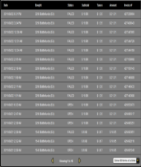









What Big Data problems can Graphs address?
Recommend the most similar item purchased by similar people
Find out people that are central in the given network – e.g. influencer marketing
Identify group of people that are close to each other – e.g. target group marketing
Find out all the sets of entities that match to the given pattern – e.g. fraud detection
Product Recommendation
Influencer Identification
Community Detection
Graph Pattern Matching
customer
items
Purchase Record
Communication Stream (e.g. tweets)
Notes:
Recommendation systems however infer links based on commonality or correlations in properties or links. For example, you rated Goodwill Hunting as 5. You are then implicitly linked to others who also rated it a 5 and then the set of other movies they rate a 5 is used to suggest movies you may want to watch. So the community of folks who like movies like Goodwill Hunting is computed from inferred links rather than explicit links.
Influencers is standard social network analysis. It is determined by things like Centrality, connectedness
Community detection is about finding subgraphs (or groups) that are already linked to each (i.e. the links exist) other and who mostly interact with each (tweet to, follow) other and there are much fewer, if any, links or interactions outside the group.
Fraud detection is special in that it uses a combination of statistical, data mining, and graph analysis to find anomalies.
The first one is the product recommendation use case which all of us have probably seen with Amazon , eBay, etc. where by looking at the purchasing behavior of similar customers, a set of products or services are recommended. Recommendation engines infer what you like based on commonality or correlations in properties or links among nodes. You can use graph technologies very effectively to address these kinds of use cases. Sentiment analysis and customer analytics come into play.
The second one is identifying influencers in a network. For example doing churn analysis, if someone leaves or buys then who is likely to follow. This involves analyzing centrality and reach. Graph analytics can help you discover who is the most connected and what is the extent of their reach. Highly connected nodes that have many links that are also linked to others are likely to represent key influencers.
The third one is community detection and is useful in typical social network analysis. Communities are subgraphs or groups that are tightly linked to each other with fewer connections outside the subgraph. There are algorithms to help you detect different kinds of communities and clusters, such as which groups of entities are connected to each other for targeted marketing, identifying terrorist cells, etc.
The fourth use case is around pattern matching. This may involve multiple analytics, for instance community detection followed by search for similar patterns of relationships. This is very useful in cyber-security and in fraud detection. Fraud detection, for example, is a specialized combination of statistics, data mining, and graph analysis to find anomalies.

Slide 10
Modeling and Analyzing The Internet of Things
Massive scale – Trillions of Connections
Dynamic Network
Includes metadata as well as events/enriched data
Extensible by other data source
Notes:
JUST TALK ABOUT SCALE – GRAPH DESIGNED TO HANGLE THE SCALE OF IOT ANALYSIS

Slide 11
Modeling and Analyzing The Internet of Things
Cyber-Security
Critical / Alternate Path Analysis Community Detection Network Monitoring Predictive Analysis
Multiple System Impact Analysis
Transportation Utilities Finance

Slide 12
Big Data Spatial and Graph
Property Graph
Notes:
This is a Section Header with Picture slide ideal for including a picture with a brief title and optional subtitle. This slide can also be used as a Q and A slide.
To customize this slide with your own picture:
Right-click the slide area and choose Format Background from the pop-up menu. From the Fill menu, click Picture and texture fill. Under Insert from: click File. Locate your new picture and click Insert.
To copy this background to another presentation on PC
Locate and open the presentation where you will be placing this artwork. Click New Slide from the Home tab's Slides group and select Reuse Slides.
Click Browse in the Reuse Slides panel and select Browse Files. Double-click the PowerPoint presentation that contains the background you wish to copy.
Check Keep Source Formatting and click the slide that contains the background you want.
Click the left-hand slide preview to which you wish to apply the new master layout.
Apply New Layout (Important): Right-click any selected slide, point to Layout, and click the slide containing the desired layout from the layout gallery.
Delete any unwanted slides or duplicates.
To copy this background to another presentation on Mac
Locate and open the presentation where you will be placing this artwork. Click New Slide from the Home tab's Slides group and select Insert Slides from Other Presentation…
Navigate to the PowerPoint presentation file that contains the background you wish to copy. Double-click or press Insert. This prompts the Slide Finder dialogue box.
Make sure Keep design of original slides is unchecked and click the slide(s) that contains the background you want. Hold Shift key to select multiple slides.
Click the left-hand slide preview to which you wish to apply the new master layout.
Apply New Layout (Important): Click Layout from the Home tab's Slides group, and click the slide containing the desired layout from the layout gallery.
Delete any unwanted slides or duplicates.

Slide 13
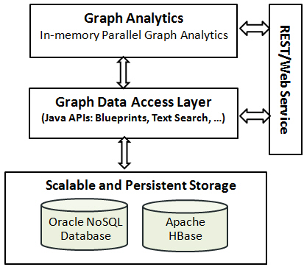
Big Data Graph Architecture
In-Memory Analyst
Lightning-Fast In-Memory Analytics
YARN Container
Standalone Server
Embedded
Massively Scalable Graph Store
Oracle NoSQL
HBase
Notes:
The in-memory analyst can be conveniently deployed depending on application requirements.
» YARN The Batch approach: Finally, the analytics can be scheduled with Apache Hadoop YARN. YARN can find the necessary CPU and memory resources within the Hadoop cluster to deploy the in-memory analyst.
» STAND ALONE The Remote approach: If multiple sessions will be invoking the in-memory analyst, it may be more efficient to deploy it once in a Web container. The supported containers are Oracle WebLogic Server, Apache Tomcat, and Eclipse Jetty.
» IN THE APP The Embedded approach: This method embeds the analytics within the user’s Java application. The analytics will execute the application’s memory space. This is an efficient single user approach if sufficient memory is available.

Slide 14
Scales to Trillions of Edges
Leverage HBase or Oracle NoSQL for massive storage scalability
Use underlying engine for node/edge access and graph filtering
Server 1
Server 2
Server 3
Notes:
DAL USES CAPABILITIES OF DB TO ACCESS NODES AND EDGES – FILTERS GRAPH FOR PARTS RELEVANT TO ANALYSIS
DEPENDS ON CAPABILITIES OF THE UNDERLYING SERVER

Slide 15


In-Memory Analyst
Analyst engine runs on one or more servers
Users request loads subgraph of interest into engine
Users call simple functions for complex analyses
Write results back or share on-the-fly
Graph Database
Analyst A
Analyst B

Slide 16





Multiple Interfaces for Many Kinds of Users
In-Memory Analyst
Graph Database

Slide 17
35 Graph Functions
Detecting Components and Communities
Ranking and Walking
Pagerank, Personalized Pagerank,
Betweenness Centrality (w/ variants),
Closeness Centrality, Degree Centrality,
Eigenvector Centrality, HITS,
Random walking and sampling (w/ variants)
Tarjan’s, Kosaraju’s,
Weakly Connected Components, Label Propagation (w/ variants), Soman and Narang’s
Evaluating Community Structures
Path-Finding
Hop-Distance (BFS)
Dijkstra’s,
Bi-directional Dijkstra’s
Bellman-Ford’s
Conductance, Modularity
Clustering Coefficient (Triangle Counting)
Adamic-Adar
∑
∑
Link Prediction
Other Classics
SALSA
(Twitter’s Who-to-follow)
Vertex Cover
Minimum Spanning-Tree(Prim’s)

Slide 18
Coding Graph Analysis Can Be Complicated
Find the size of the 2-hop network of superheroes (Gremlin+Python)
sum([v.query() \
.direction(blueprints.Direction.OUT).count() \
for v in OPGIterator(v0.query() \
.direction(blueprints.Direction.OUT) \
.vertices().iterator())])
Computing “importance” is more nebulous and harder to code
Iron Man
Thor
Ant-Man
Cpt.
Amer
Hulk
Wasp

Slide 19
Importance as Degree Centrality
The more edges a vertex has, the higher its degree
The greater the degree, the more important the vertex is
This is one way to look at importance
Is your most connected customer most important?
Iron Man
Cpt.
Amer

Slide 20
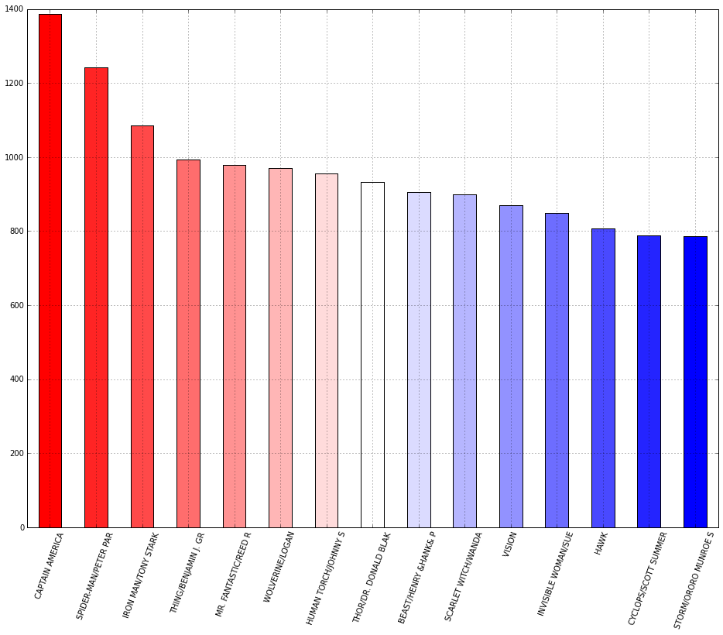
Degree Centrality in Big Data Graph
Code
heroInfluence = analyst.inDegreeCentrality()

Slide 21
Importance as Page Rank
Importance can flow through a graph
A node connected to by important nodes is also important
This is importance as a measure of
Trust
Prominence
Thinking about customers in a graph requires multiple definitions of importance
Iron Man
Cpt.
Amer
Rocket Racer

Slide 22
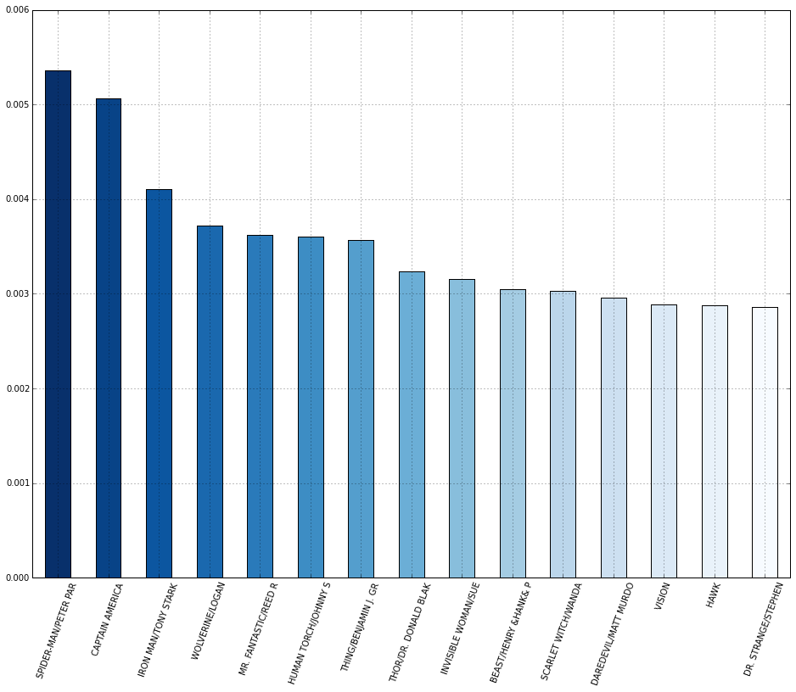
Page Rank in Big Data Graph
Code
heroPR = analyst.pageRank().topK(15)

Slide 23
Importance as “Between-ness”
Importance can be how often you’re on the critical path
Betweenness is the number of shortest paths a node is part of
Cpt.
Amer
IceMan
Beast
Iron Man
Thor
Wolverine
Prof X
Ant-Man
Cyclops
Hulk
Wasp

Slide 24
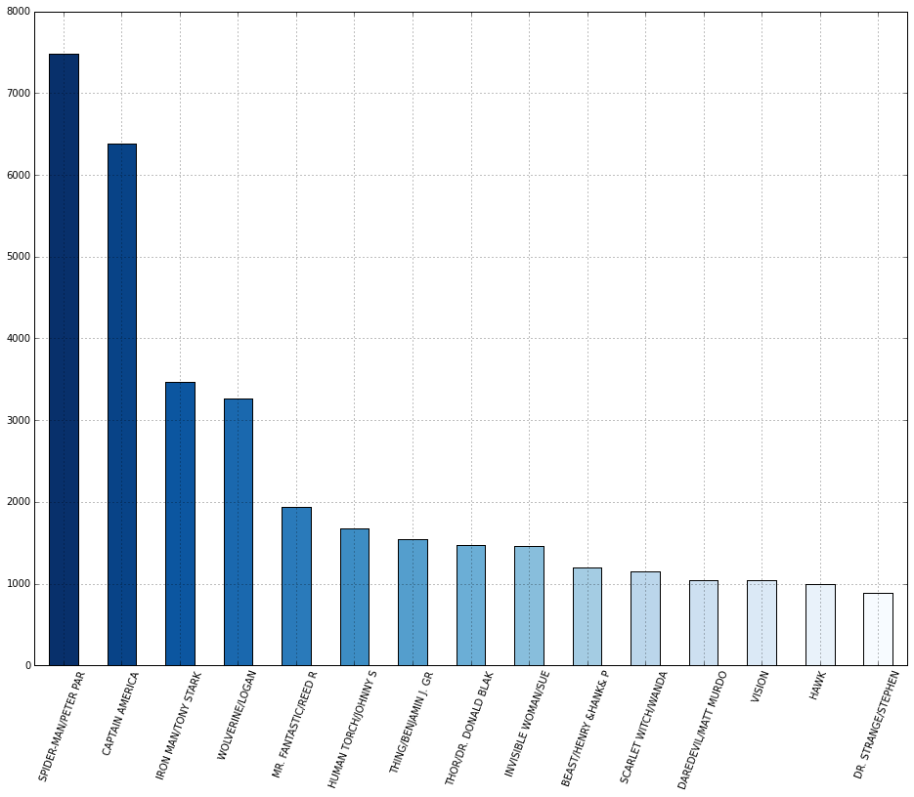
Betweenness Centrality in Big Data Graph
Code
b = analyst.betweenness().topK(15)

Slide 25
Communities Are Just Special Subgraphs
Community
A subgraph in which
Nodes are more connected to each other
Communities provoke interesting questions
How many?, How large?
How do they relate to each other?
Analyses can be performed on a community
Who’s the most valuable customer in a community?
Iron Man
Thor
Ant-Man
Cpt.
Amer
Hulk
Wasp

Slide 26
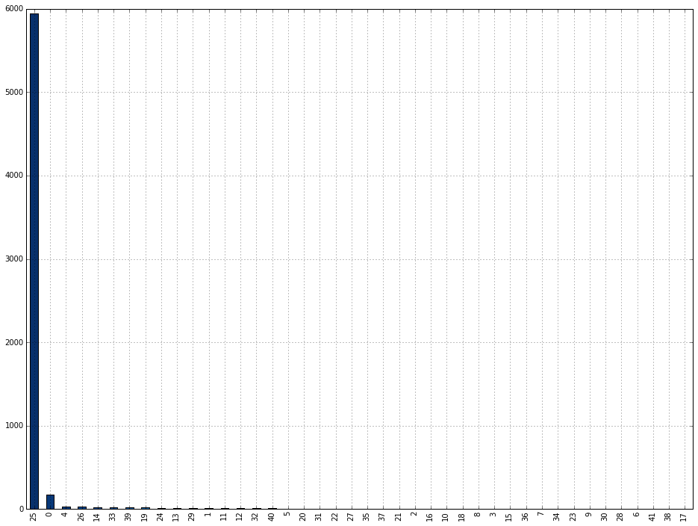
Community Detection in Big Data Graph
Code
comic_coms = analyst.communities()

Slide 27
Differentiators -- Graph
Commercial, supported software
“Best of Both Worlds” Graph DB
In-memory graph analysis algorithms – Like Neo4J
Distributed graph database model – Like Datastax Titan
Dozens of pre-built in-memory graph analysis algorithms
10-50x faster analytics than competitors’ offerings
Analyze 20-30 Billion edge graph in memory on a single BDA node

Slide 28
Big Data Spatial and Graph
Spatial Analytics and Services
Notes:
This is a Section Header with Picture slide ideal for including a picture with a brief title and optional subtitle. This slide can also be used as a Q and A slide.
To customize this slide with your own picture:
Right-click the slide area and choose Format Background from the pop-up menu. From the Fill menu, click Picture and texture fill. Under Insert from: click File. Locate your new picture and click Insert.
To copy this background to another presentation on PC
Locate and open the presentation where you will be placing this artwork. Click New Slide from the Home tab's Slides group and select Reuse Slides.
Click Browse in the Reuse Slides panel and select Browse Files. Double-click the PowerPoint presentation that contains the background you wish to copy.
Check Keep Source Formatting and click the slide that contains the background you want.
Click the left-hand slide preview to which you wish to apply the new master layout.
Apply New Layout (Important): Right-click any selected slide, point to Layout, and click the slide containing the desired layout from the layout gallery.
Delete any unwanted slides or duplicates.
To copy this background to another presentation on Mac
Locate and open the presentation where you will be placing this artwork. Click New Slide from the Home tab's Slides group and select Insert Slides from Other Presentation…
Navigate to the PowerPoint presentation file that contains the background you wish to copy. Double-click or press Insert. This prompts the Slide Finder dialogue box.
Make sure Keep design of original slides is unchecked and click the slide(s) that contains the background you want. Hold Shift key to select multiple slides.
Click the left-hand slide preview to which you wish to apply the new master layout.
Apply New Layout (Important): Click Layout from the Home tab's Slides group, and click the slide containing the desired layout from the layout gallery.
Delete any unwanted slides or duplicates.

Slide 29





Motivation for Oracle Big Data Spatial
Emergence of Hadoop for spatial analysis in business and spatial workflows Existing Hadoop-based Spatial technologies are GeoSpatial-centric not Application-centric
No significant commercial offerings
Notes:
Existing Hadoop-based Spatial technologies are GeoSpatial-centric not Application-centric
Data is organized on spatial key, less suitable for combined spatial/non-spatial analytics
Cannot work on any data that includes location info, datatype and file format
No significant commercial offerings
Unsupported GitHub code
U. Minnesota SpatialHadoop
Accumulo-specific GeoMesa
Emergence of Hadoop for spatial processing and analysis in spatial workflows

Slide 30



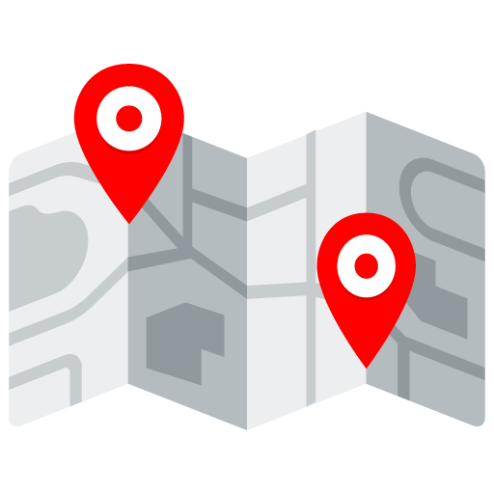
What problems can Big Data Spatial analysis address?
Data Harmonization using any location attribute (address, postal code, lat/long, placename, etc).
Categorization and filtering based on location and proximity
Preparation, validation and cleansing of Spatial and Raster data
Visualizing and displaying results on a map
Notes:
SpatialIndexing
Categorization
KMeansClustering
Binning
SpatialFilter
SuggestService

Slide 31
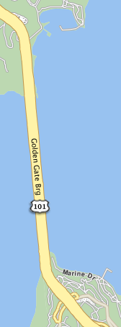
Data Harmonization: Linking information by location
Are these data points related?
Tweet: sailing by #goldengate
Instagram image subtitle: 골든게이트 교*
Text message: Driving on 101 North , just reached border between Marin County and San Francisco County
GPS Sensor: N 37°49′11″ W 122°28′44″
Now find all data points around Golden Gate Bridge ...
* Golden Gate Bridge (in Korean)

Slide 32





Use Case: Linking Information by Location Insurance Industry
86%
Of Insurance companies agree that analyzing multiple data sources together is crucial to making accurate predictions
Agree that linking information by location is key to combining disparate sources of Big Data
Actuarial and Demographic data
Accident data
Call data
Customer data
88%
Enrich with Postal Code
Categorize by Region
Data Products for Rate Structures Underwriting/Risk Analysis
Source: “The big data: How data analytics can yield underwriting gold.” Survey conducted by Ordnance Survey and Chartered Insurance Institute, 25 April 2013.

Slide 33
What features does Big Data Spatial have?
Data enrichment service API using GeoNames and geometry hierarchy data
MapReduce routines for distance calculations, PointInPolygon, buffer creation, Categorization, KMeansClustering, Binning, etc.
Spatial processing of data stored in HDFS. Raster processing operations: Mosaic and sub-set operations. Geodetic and Cartesian data
HTML5 Map Visualization API
Notes:
Vector Data Processing
Support spatial processing of data stored in HDFS
Commonly used operations like PointInPolygon, buffer creation, distance calculations, anyinteract operations, etc.
Advanced categorization and filtering operations like SpatialIndexing, Categorization, KMeansClustering, Binning, etc.
Supports both
Data enrichment services using GeoNames and geometry hierarchy data
Map Visualization API (HTML5
Raster Data Processing
GDAL to load raster data onto HDFS
Raster processing operations: Mosaic and sub-set operations
Map-Reduce framework for raster analysis operations (for example, calculate the slope at each pixel based on the DEM)

Slide 34
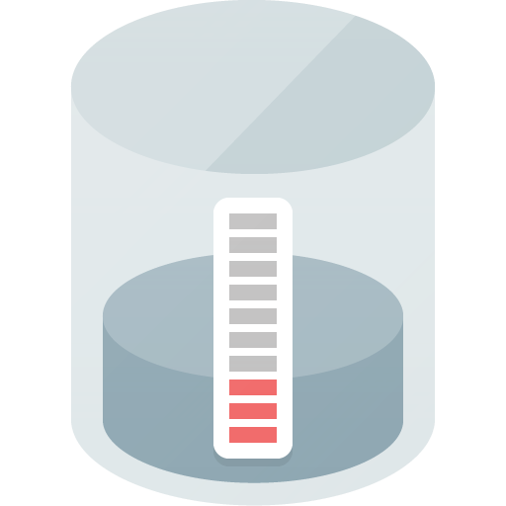

Store any business data with spatial information in HDFS
USER-PROVIDED
InputFormat/RecordReader Class
Oracle JGeometry
LOAD ANY FORMAT
ANY BUSINESS DATA
HDFS
Notes:
Customers load their data into HDFS using a loader of their choice
We do not require the data to be in a format that we specify
This makes it easy for customers to use any data format their applications prefer
And the data can have other business data and not just spatial data
We require the customer to provide the InputFormat/RecordReader class
The RecordReader implementation reads the customer data record and produces an instance of JGeometry
With this model we can support any data format customers use for their data

Slide 35
Vector Data Processing API Functions
Single Geometry
Length
Area
Buffer
Simplify
Geometry Pairs
Range Queries
Point in Polygon
Touch, Overlap, Intersect, Contains, Any Interaction
Join Queries
Interactions on sets of data
E.g.: Find all the dropped cell calls in all coverage areas
Categorization and Enrichment
Associate a data set with a known geometry or named hierarchy
Process all Tweets for a period of time and count how many are associated with each city, county, state, etc.
Notes:
Our API is broadly divided into three categories
Functions that operate on a single geometry at a time
Buffer, simplify, length, area, etc.
Functions that operate on a pair of geometries at a time
Range-Queries: these are the typical PointInPolygon, AnyInteract type of operations
Analogous to our operators and relate functions in the DB
Join-Queries: This is the typical Spatial-Join operation where two data sets are joined to find all the interacting pairs of geometries (next release)
Functions that categorize and enrich data
Associating a data set with a known geometry or named hierarchy
For example, process all tweets for a time period and count how many tweets are associated with each city, county, state, etc.

Slide 36
Data Categorization Services
Any hierarchical geometry data set for reference
Customers choose a set of layers For example, they can select (continents, countries, cities) or (countries, states, counties) as the hierarchy
Big Data Spatial map-reduce job processes the customer data and produces a result file
Notes:
Any hierarchical geometry data set can be used as a reference data
We provide some well known geometry layers but the customers can use any sets of data layers
This data is stored as GeoJSON data
Customers choose a set of layers they want to use
For example, they can select (continents, countries, cities) or (countries, states, counties) as the hierarchy
We create a map-reduce job and process the customer data and produce a result file that can be used for further processing
For example, a summary file that can be used to visualize the categorized data on a map

Slide 37
Spatial Index for Spatial Queries
MapReduce Job with Index
Copy the index to distributed cache
Spatial Index stored as a MapFile
Mapper reads the index data for the corresponding HDFS block
Data Blocks
Data Blocks
Data Blocks
Data Blocks
Process only those records that return hits from the index search
HDFS
Notes:
LOCAL SPATIAL INDEX
Randomly spread the data across all the nodes in the cluster
Create a local spatial index at each node
All nodes participate in processing the query
No single node bottleneck against overload
Latency is lower since each node only has to process a small amount of data
Example
A large number of records/logs with lat/long information along with other attributes
Find all the records that are within 10 miles from the given lat/long and also contain the phrase “united nations”

Slide 38
How is Spatial Indexing used ?
Performance of some of the Spatial processing operations can be improved by using spatial indexes
When the map-reduce job is created, user can specify whether to use or not use the spatial index
Spatial index data is placed in Hadoop Distributed Cache for fast access
Notes:
Performance of some of the Spatial processing operations can be improved by using spatial indexes
Range-Queries can benefit from spatial indexing as secondary filter operations can be skipped for records that are not contained in the MBR of the query geometry
When the map-reduce job is created, we can specify whether to use or not use the spatial index
If spatial index is not used, each record is processed by the spatial function that is invoked
If spatial index is used, the map-reduce job only processes those records that can potentially interact with the MBR of the query geometry
Spatial index data is placed in Hadoop Distributed Cache for fast access

Slide 39
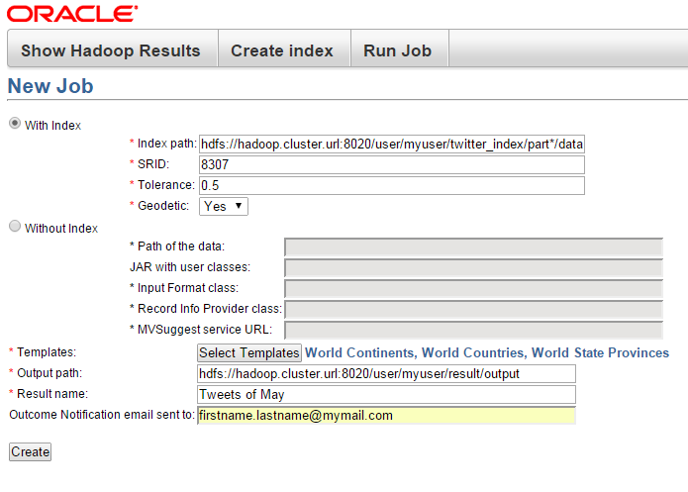
Spatial Server Console
A sample J2EE application that can be deployed in Jetty
Create spatial indexes on data that is already loaded into HDFS
Run Hadoop jobs to do spatial processing
This will create and run the categorization MapReduce job that can use a provided spatial index or read each input record
Sample map application that can display results of a categorization job

Slide 40
Big Data Spatial and Graph Spatial Vector Processing Framework
Customer Application
Sample
Console Application
Mapper and Reducer
Classes
MapReduce Framework, templates
S&G Java API
Spatial Operators, Functions
Spatial Enrichment, Categorization API
Customer data
Generated data
GeoJSON, JGeometry format
Oracle Provided
GeoNames and Hierarchy data
Customer code
RecordReader class
HDFS
Spatial Content
(any format)
Enrichments, Categorizations results

Slide 41
Image Server
HDFS storage for the image or raster files
We can support dozens of file formats (GDAL supported formats)
Images are geo-referenced
Images can be in different coordinate systems and resolutions
Three main capabilities
Loader to load raster data from NFS to HDFS
Mosaic and subset operations based on a virtual mosaic
Image processing framework for raster analysis

Slide 42
Big Data Spatial and Graph Spatial Raster Processing Framework
Raster Analysis Application
Sample Console Application
Raster MapReduce framework
S&G Java API
Analysis Algorithms
Customer data
Subset
Mosaic
Raster Analysis API
Generated data
Oracle Provided
Customer code
Raster Data Files on NFS
HDFS
Raster catalog
Derived Rasters
GDAL Loader
(GDAL formats)
Rasters

Slide 43
Why Spatial and Graph Together?

Slide 44
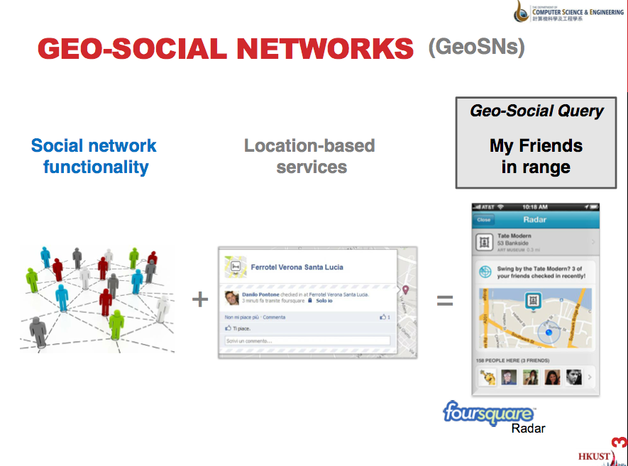
Courtesy: 14th International Symposium on Spatial and Temporal Databases
Drimitris Papadias (HKUST, Hong Kong)

Slide 45
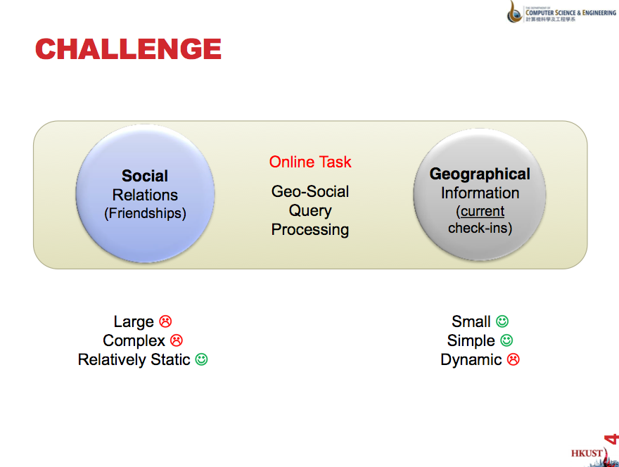
Courtesy: 14th International Symposium on Spatial and Temporal Databases
Drimitris Papadias (HKUST, Hong Kong)

Slide 46
GeoSocial Analysis Use Cases: “Nearest Friends”
“It’s 11:30. Want to meet Jon, Melli, and Albert for lunch @Milano’s today at Noon?”
URGENCY WITH LIMITED AVAILABILITY: Lunch promotion to targeted potential “table of 4” who know each other within 1 km.
“Great seats @ Cinema 18 for 7:30 show of new Avengers movie tonite. Free popcorn and soft drink for you and Mary. Text her at 555-1234.”
TIME CONSTRAINED: Target people within 20 minute drive 30 minutes before the show.
“We know you and your old college buddies love Elton John. Get together with Tom, Dick and Hari and the rest of the frat next month.”
BROADER SOCIAL REACH; WIDER DISTANCE. NO TIME CONSTRAINT: Concert promotion.

Slide 47

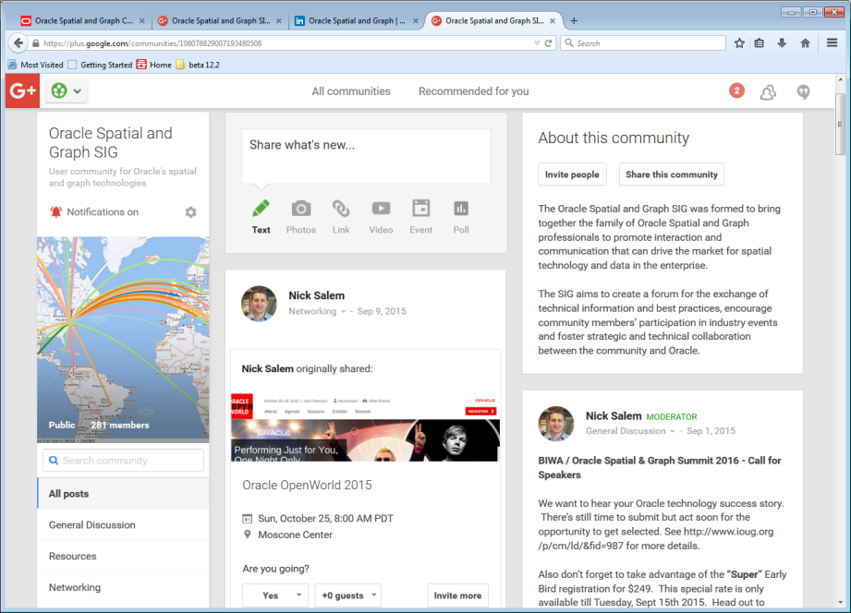
The Spatial & Graph User Community
Connect & exchange knowledge via online communities, conferences & events
Join us online
Find us at LinkedIn and Google+
Search for “Oracle Spatial Community”

Slide 48




Oracle Spatial Summit at BIWA 2016 Jan. 26-28 | Oracle HQ Conference Center Business Intelligence, Warehousing, and Analytics + Spatial & Graph IOUG Special Interest Groups (SIGs) *Register by November 15th for Early Bird rates *Final Call for Speaker Abstracts – Submit by November 2 www.biwasummit.org
Notes:
48
Our major conference, the Oracle Spatial Summit, will be held in Jan. 2016, at Oracle headquarters in California. We will again partner with the BIWA (Business Intelligence, Warehousing, and Analytics).
The user groups for Spatial, BI, Analytics, and N. California organize this valuable two and a half day event. It will include technical sessions, keynote speakers including Oracle execs and industry leaders, labs, and case studies on topics from big data, BI, and analytics to spatial and GIS.
Early bird discounts are now available for registration
Last call for speaker abstracts – submit by November 2nd if you’ve got a case study or technology you’d like to share. Check out the website at www.biwasummit.org for details.
Scheduled sessions include:
Technical Sessions from the Oracle Product Team:
Best Practices, Tips, and Tricks with Oracle Spatial and Graph
Raster Analysis and Processing with Oracle Spatial and Graph
3D Data Management - From Point Cloud to City Model (including Use Cases)
Many Graphs for Many Uses: An Introduction to RDF, Property, and Network Graphs
Hands-On Labs:
Applying Spatial Analysis to Big Data
Interactive Map Visualization of Large Datasets in Analytic Applications
Customer/Partner Sessions:
Best Practices for Developing Geospatial Apps for the Cloud
BI Movie Magic: Maps, Graphs, and BI Dashboards at AMC Theatres

Slide 49
Q&A
Notes:
DON’T FORGET TO DO THE NEXT BATCH OF SLIDES -- DEMO PODS, OTHER SESSIONS, SIG, USER CONF.

